Slide 1
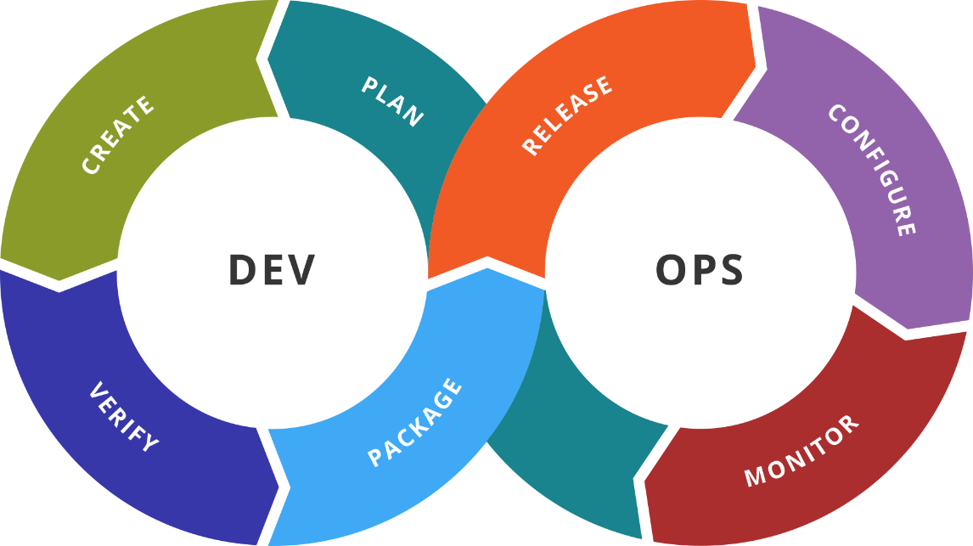
Exam Preparation
Course Overview. Exam Logistics and Preparation
SoftUni Team
Technical Trainers
Software University
https://softuni.org

Slide 2
You Have Questions?
sli.do
#DevOps-23
facebook.com
/groups/DevOpsContainerizationCICDMonitoringJanuary2023

Slide 3
Homework Progress
Solutions for M7
can be submitted
until 23:59 on 22.03.2023

Slide 4
The End is Here ☺
THIS IS OUR
LAST MODULE
FIRST (REGULAR) EXAM IS ON
26.03.2023 (SUNDAY)

Slide 5

Previous Module (M7)
Quick Overview

Slide 6
What We Covered
Elastic Stack
Elasticsearch
Logstash
Kibana
Beats
Elastic Stack and Docker

Slide 7

Dev
Ops
This Module (M8)
Topics

Slide 8
Table of Contents
Course Overview
Exam Logistics
Exam Preparation
Theoretical Exam Simulation
Practice Exam Simulation

Slide 9
Dev
Ops
Course Overview
A Short Summary

Slide 10
Course Overview (1)
Week #1
DevOps basic principles
Processes and tools
Virtualization and basic automation with Vagrant
Week #2
Containerization basic principles
Introduction to Docker
Installation and configuration of Docker
Working with images and containers

Slide 11
Course Overview (2)
Week #3
Additional techniques
Distributed applications
Docker clusters
Week #4
Introduction to Jenkins
Installation and configuration of Jenkins
Working with Jenkins

Slide 12
Course Overview (3)
Week #5
Additional techniques with Jenkins
Distributed workload
Week #6
Introduction to Prometheus and Grafana
Installation and configuration of Prometheus and Grafana
Working with Prometheus and Grafana

Slide 13
Course Overview (4)
Week #7
Introduction to Elastic Stack
Installation and configuration of Elastic Stack
Working with Elastic Stack

Slide 14
Dev
Ops
Exam Logistics
Scoring. Components. Next Steps

Slide 15






Scoring
TEST
40 pts.
TEAM
PLAY
HOMEWORK
BONUS
10 pts.
PRACTICE
EXAM
60 pts.
EVALUATION
CRITERIA

Slide 16
Exam: Practice *
Create and configure the required infrastructure
Deploy and configure the necessary tools and components
Fulfill the requirements in the most automated way possible
Additional tasks as per the exam requirements
Prove the solution is working as per the requirements
(1) The practice exam will be held your own infrastructure (as usual)
(2) The exam duration is 4 hours (between 09:00 and 13:00**)
(3) There will be 30 more minute (until 13:30) to prepare an upload your solution proof
* You are allowed to use any available source of information during the exam

Slide 17
Practice Preparation
Focus on what was demonstrated during the lectures
Go over the practice exercises at least once more
Check the homework challenges and the published solutions
Repeat the sample practice exam solution
Experiment a little bit

Slide 18
Exam: Test *
30
minutes
20
single-choice
questions
10
multi-choice
questions
(1) The test exam will be held remotely in https://quiz.softuni.bg
(2) The exam can be started at any time between 09:00 and 13:29
* You are allowed to use any available source of information during the exam

Slide 19
Test Preparation
Practice (exam-like) questions:
https://zahariev.pro/q/do1

Slide 20
(Next) Steps
23.03. – Last homework solution will be published
26.03. – Exam time ☺
Exam(s) will take place between 9:00 and 13:30 *
* The time between 13:00 and 13:30 is for uploading your solution and doing the test eventually

Slide 21
Dev
Ops
Exam Preparation
Let’s Do It

Slide 22
Questions?
Notes:
22

Slide 23














SoftUni Diamond Partners

Slide 24

Educational Partners

Slide 25

License
This course (slides, examples, demos, exercises, homework, documents, videos and other assets) is copyrighted content
Unauthorized copy, reproduction or use is illegal
© SoftUni – https://softuni.org
© Software University – https://softuni.bg
Notes:
25

Slide 26
Trainings @ Software University (SoftUni)
Software University – High-Quality Education, Profession and Job for Software Developers
softuni.bg, softuni.org
Software University Foundation
softuni.foundation
Software University @ Facebook
facebook.com/SoftwareUniversity
Software University Forums
forum.softuni.bg
Notes:
26

